Slide 1



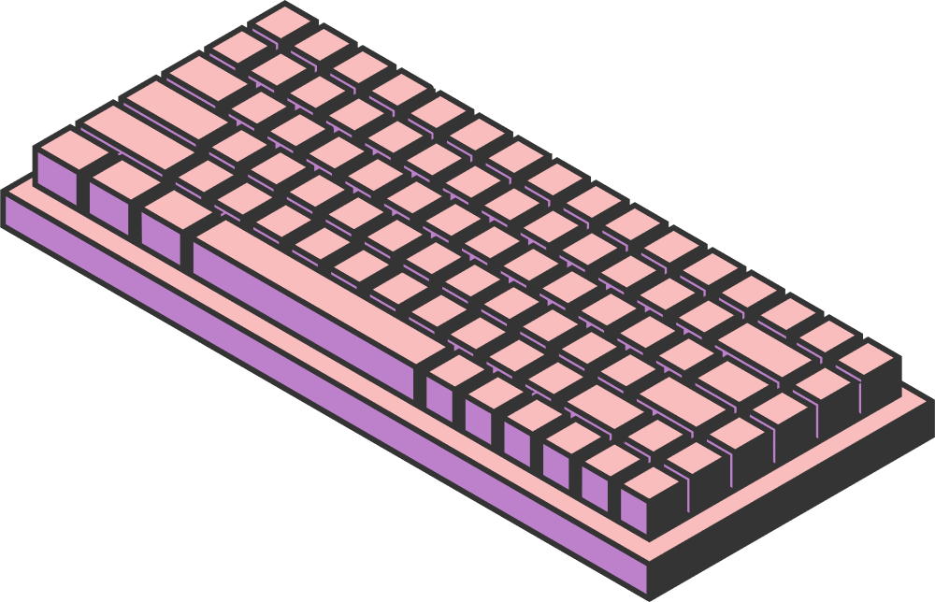
REAL-TIME PARKING OCCUPANCY ANALYTICS USING YOLO OBJECT DETECTION AND REAL-TIME DATA PIPELINES
22MIA1094 - Anirudh R
22MIA1108 - Inesh S T
Submitted to Dr. Gayathri Devi S
Page 01

Slide 2

INTRODUCTION
Background: Smart City applications, like Computer Vision (CV), generate unique and demanding data streams.
The Problem: Generic MongoDB optimization guides are not designed for the specific challenges of high-frequency CV workloads.
The Consequence: Applying standard practices leads to performance bottlenecks, high storage costs, and slow analytics.
Our Approach: Use a real-time Smart Parking system as a testbed to develop and validate a CV-specific optimization framework for MongoDB.
Page 02

Slide 3


LITERATURE REVIEW - KEY THEMES
Theme 1: MongoDB Performance Tuning
Existing research is generic; not tailored for CV data patterns.
Theme 2: Real-time Analytics Features
Performance of features like Time-Series is unknown for demanding CV workloads.
Theme 3: Smart Parking Architectures
Current systems lack detailed, optimized data management strategies, especially for NoSQL.
Page 04

Slide 4

RESEARCH GAPS
Gap 1: Schema Design
No established patterns for structuring CV detection data (bounding boxes, scores) for both fast writes and efficient queries.
Gap 2: Indexing Strategy
The performance cost of complex indexes under high-frequency CV data ingestion is unknown.
Gap 3: Analytics Efficiency
How to run complex aggregation queries without slowing down the real-time system.
Gap 4: Configuration Tuning
Lack of guidelines for tuning MongoDB (e.g., sharding, write concern) specifically for CV data streams.
Page 05

Slide 5

SCOPE AND PROBLEM STATEMENT
Scope
Database: MongoDB
Optimization Focus: Schema, Indexing, Aggregation, Configuration
Domain: YOLO-based Smart Parking
Metrics: Throughput, Latency, Query Efficiency, Storage Footprint
Problem Statement
To define and validate optimal MongoDB strategies (schema, indexing, configuration) specifically for the demands of real-time computer vision workloads.
Research Questions
What is the best document structure for CV data?
Which indexing strategy balances write speed and query performance?
How can we optimize the Aggregation Framework for real-time analytics?
Page 07

Slide 6
RESEARCH CHALLENGES
Write vs. Read Trade-off
Balancing high-speed data ingestion with fast analytical query performance.
Index Overhead
Finding the minimal set of indexes that help queries without slowing down writes.
Data Growth & Scalability
Managing massive historical data while maintaining real-time system responsiveness.
Experimental Control
Isolating variables and creating a realistic workload simulation.
Page 08

Slide 7
METHODOLOGY
Phase 1: Baseline System
Implement a "naive" system with default settings to establish baseline performance metrics.
Phase 2: Iterative Optimization & Benchmarking
Systematically test and measure the impact of different schema, indexing, and aggregation strategies.
Phase 3: Scalability Testing
Simulate increased load (more cameras, more users) to evaluate performance and test sharding.
Workload Simulation
Use Python scripts to mimic high-frequency writes (from YOLO) and concurrent reads (from mobile apps).
Page 09

Slide 8


DATASET DESCRIPTION
Primary Dataset: Synthetic Vehicle Detection Data
Key Attributes: timestamp, camera_id, spot_id, occupied, confidence_score, bounding_box
Data Source: Generated by a script to simulate a high volume of detections from multiple cameras.
Metadata: Separate collections for Parking Lot Geometry (GeoJSON) and Camera information.
Benchmark Queries: A mix of real-time (availability), historical (trends), and geospatial (nearest spot) queries.
Page 06

Slide 9
REFERENCES
Cooper, B.F., Silberstein, A., Tam, E., Ramakrishnan, R., & Sears, R. (2010). Benchmarking cloud serving systems with YCSB. Proceedings of the 1st ACM Symposium on Cloud Computing, 143-154.
Cattell, R. (2011). Scalable SQL and NoSQL data stores. ACM SIGMOD Record, 39(4), 12-27.
Davoudian, A., Chen, L., & Liu, M. (2018). A survey on NoSQL stores. ACM Computing Surveys, 51(2), 1-43.
Abramova, V., Bernardino, J., & Furtado, P. (2014). Which NoSQL database? A performance overview. Open Journal of Databases, 1(2), 17-24.
Sunder, R., & Vadivel, A. (2016). Performance evaluation of NoSQL databases for large scale data analytics. International Journal of Computer Applications, 142(8), 1-6.
Li, Y., Terrell, J., & Patel, J.M. (2019). Database systems for modern applications: Private, secure, and fast. Communications of the ACM, 62(5), 110-119.
Stonebraker, M., & Cetintemel, U. (2005). "One size fits all": An idea whose time has come and gone. Proceedings of the 21st International Conference on Data Engineering, 2-11.
Zaharia, M., Xin, R.S., Wendell, P., Das, T., Armbrust, M., Dave, A., ... & Stoica, I. (2016). Apache Spark: A unified analytics engine for large-scale data processing. Communications of the ACM, 59(11), 56-65.
Kianpisheh, A., Mustaffa, N., Limtrairut, P., & Keikhosrokiani, P. (2012). Smart parking system (SPS) architecture using ultrasonic detector. International Journal of Software Engineering and Its Applications, 6(3), 51-58.
Vlahogianni, E.I., Kepaptsoglou, K., Tsetsos, V., & Karlaftis, M.G. (2016). A real-time parking prediction system for smart cities. Journal of Intelligent Transportation Systems, 20(2), 192-204.
Rizvi, S.R., Zehra, S., & Olariu, S. (2018). A survey on the role of IoT in smart parking systems. Computer Networks, 129, 99-110.
DeCandia, G., Hastorun, D., Jampani, M., Kakulapati, G., Lakshman, A., Pilchin, A., ... & Vogels, W. (2007). Dynamo: Amazon's highly available key-value store. ACM SIGOPS Operating Systems Review, 41(6), 205-220.
Chang, F., Dean, J., Ghemawat, S., Hsieh, W.C., Wallach, D.A., Burrows, M., ... & Gruber, R.E. (2008). Bigtable: A distributed storage system for structured data. ACM Transactions on Computer Systems, 26(2), 1-26.
Lakshman, A., & Malik, P. (2010). Cassandra: A decentralized structured storage system. ACM SIGOPS Operating Systems Review, 44(2), 35-40.
Redmon, J., Divvala, S., Girshick, R., & Farhadi, A. (2016). You only look once: Unified, real-time object detection. Proceedings of the IEEE Conference on Computer Vision and Pattern Recognition, 779-788.
Page 09

Slide 10
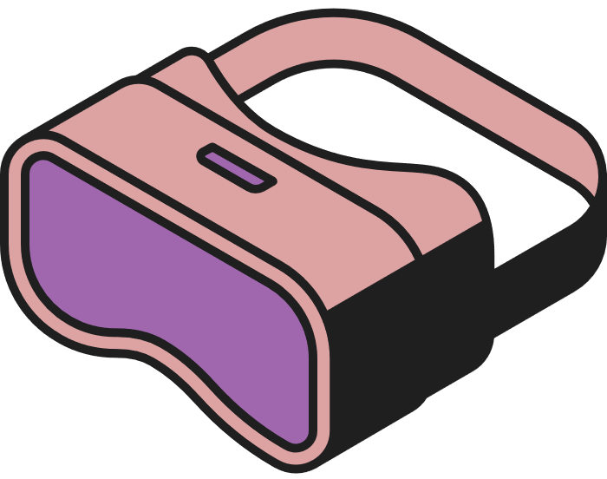



THANK YOU
Page 10

